Slide 1
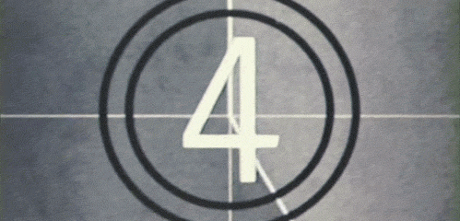

Slide 2
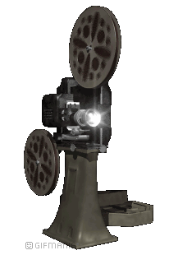
Maths in
Cinema

Slide 3
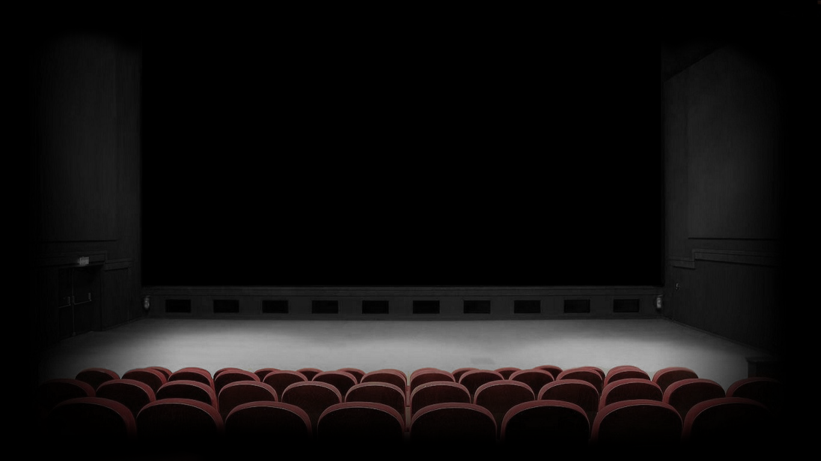
“Motion picture is a grand art form that uses elements from all other arts. So if you consider literature, photography, music as arts, then you would have to consider filmmaking an art as well because they are all integrated.”

Slide 4
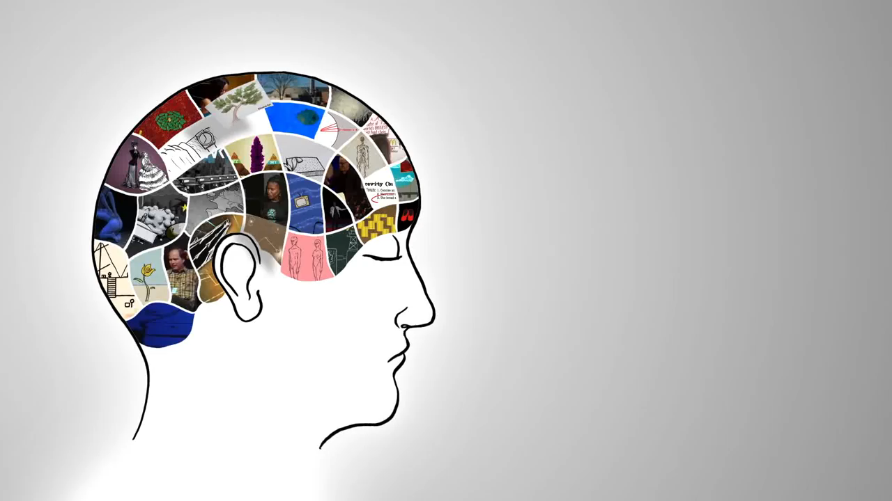

Slide 5
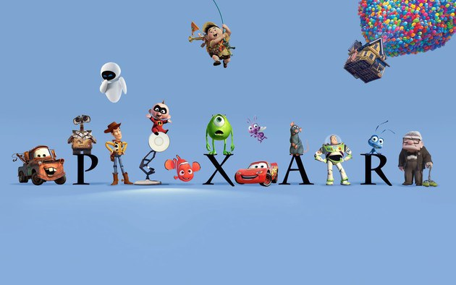

Slide 6
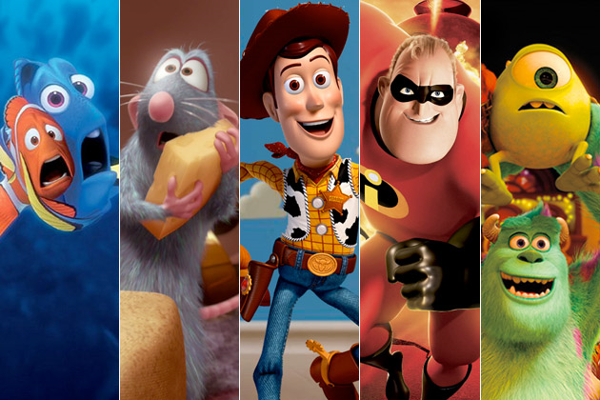
“Imagine a marionette with 700 strings; that's what our animators are dealing with.”
Tony DeRose

